Slide 1


Microsoft Azure
The cloud platform for digital transformation
Joe Raio, Senior Technical Evangelist, Microsoft
Notes:
(Introductions and set expectations that this presentation is designed to discuss the role of Azure as the cloud computing platform for a business’s digital transformation.)

Slide 2
Goals of Presentation
About Me & General Info
Azure Overview
Portal Demo
Azure Account Setup

Slide 3




Joe Raio
Senior Technical Evangelist
DX Audience
joe.raio@microsoft.com
joeraio.com
@joescars
Based in Miami, FL.
Proud father. Passions are Music, Space, Aviation & all things Technology
Notes:
What is a technical evangelist?

Slide 4
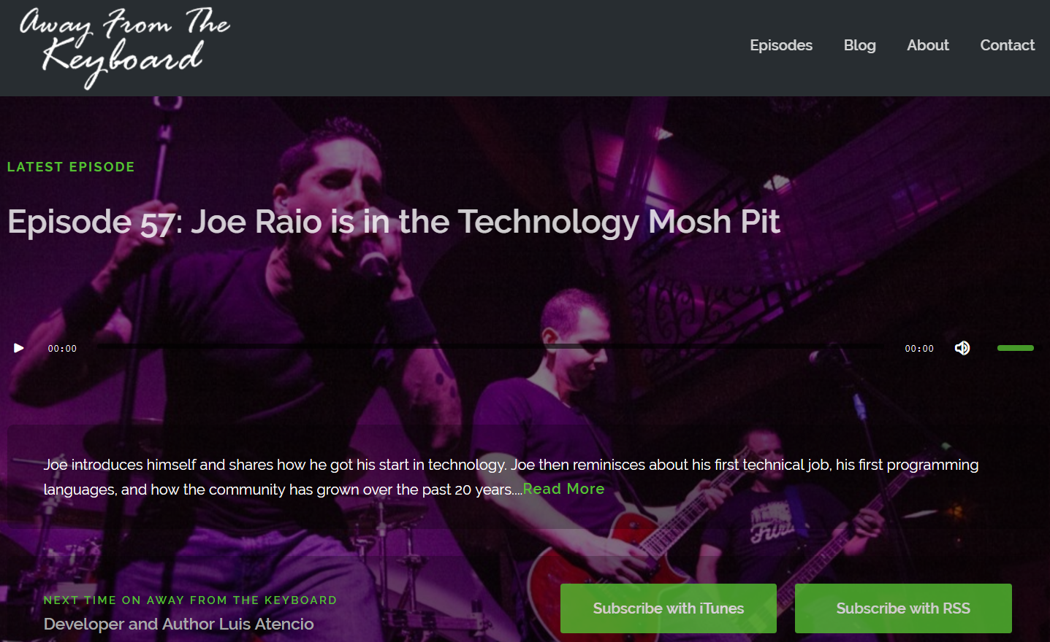
awayfromthekeyboard.com
Notes:
Learn more about me here…

Slide 5
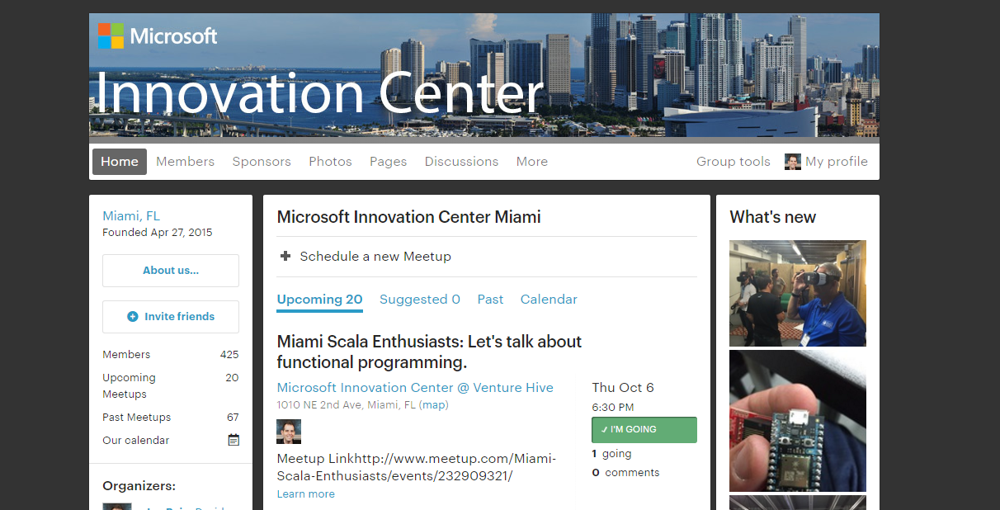
http://www.meetup.com/MICMiami/

Slide 6
Engage your customers
Transform your products
Digital transformation
Empower your employees
Optimize your operations
Notes:
Technology is omnipresent. It’s shaping how businesses plan for innovation and growth within their markets. The importance of digital transformation is urgent; Since 2000, 52% of Fortune 500 companies are gone due to digital disruption.
We see companies responding by creating digital strategies across four core areas: engaging their customers, empowering their employees, optimizing their operations, and transforming their products.
Everyone is aware of how important this is. Look at a company like Uber for example. They’ve created a digital model for the taxi industry that has allowed them to surpass every other taxi company by double or more, recently valued at $62.5 Billion. They’ve created a significant shift in an industry that has been largely untouched for decades.

Slide 7
Trust
Protect your business
Microsoft Azure
Open and Hybrid
Build freely, deploy consistently in the cloud & on-prem
App Innovation
Accelerate innovation with the cloud
Data-Driven Intelligence
Power decisions & apps with insights
Notes:
Microsoft Azure is our cloud platform for digital transformation across your business. Our strategy to this end is to provide a platform of technologies that:
1. Accelerates app innovation through rapid app development and agility in the cloud.
2. Delivers integrated data and intelligence—data for rich insights to intelligence embedded within apps.
3. Is open and hybrid, where you can use the tools and technologies you already have and want to use.
4. Is trusted to protect your business assets. As more customers expect digital experiences, they expect the data they share with an organization to be protected.

Slide 8

Protect your business
Trust
Detect and mitigate threats
Achieve global scale, in local regions
The most trusted and compliant cloud
Notes:
Trust is a topic we don’t take lightly. With Azure, as well as the broader Microsoft Cloud, we safeguard data and assets in the cloud with the security, compliance, privacy, and transparency required.

Slide 9
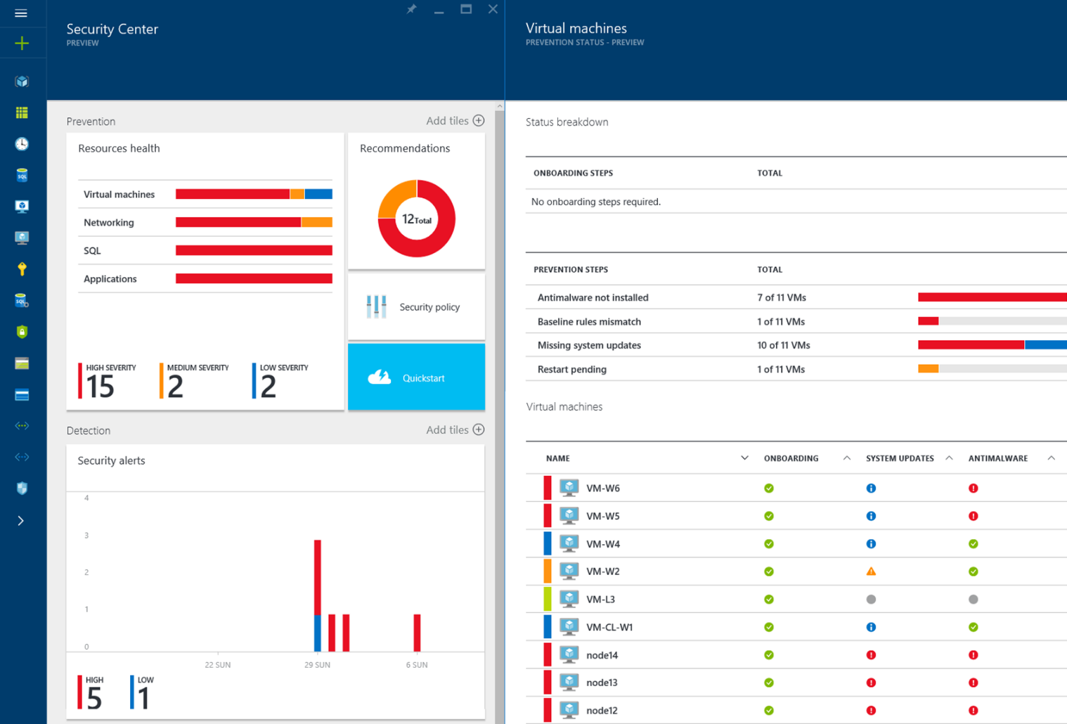
Detect and mitigate threats
Trust
Prevent
Detect
Respond

Slide 10
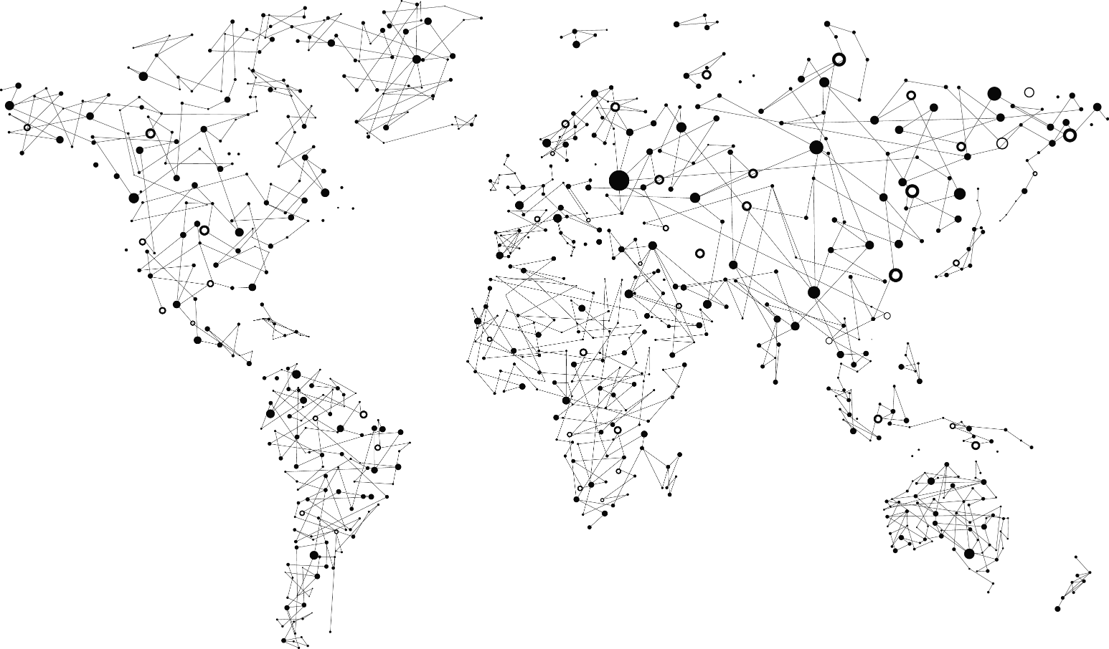
Achieve global scale, in local regions
Trust
38
Azure regions
RECENTLY LAUNCHED:
US Regions: West US 2 and West Central
Germany – Launched in Sep 2016
United Kingdom – Launched in Sep 2016
NEWLY ANNOUNCED:
France: France Central and France South
Korea: Korea Central and Korea South
DoD East and Central
Notes:
At the core of Azure is its global infrastructure that spans 38 regions worldwide. We have the largest footprint of any cloud provider – 2X that of AWS.
The security controls we apply to development, infrastructure, operations, and compliance apply to our global customer base. Customers can explicitly choose which regions to deploy and store their data according to local privacy, security, or compliance requirements.
On this slide you can see the 34 regions where we operate (26 are active), including:
Public cloud regional datacenters with geographic diversity. Customers can deploy two identical workloads in different regions with an Active/Active failover model. This can ensure business continuity in the event of a local disaster.
Local and sovereign cloud. In-country Microsoft datacenters address data residency requirements, and we’re using a combination of technology as well as a legal framework to legally isolate certain regions of the world according to local sovereignty, governance, and rule of law, all the while providing the same exact up to date set of services in those regions.
There are four sovereign clouds today and four more planned, including Germany for example, as well as:
US Gov (2)
China North Beijing
China South Shanghai
Planned:
Germany Central
Germany Northeast
US DoD East
US DoD West
https://azure.microsoft.com/en-us/regions/
https://azure.microsoft.com/en-us/regions/services/
newest version

Slide 11











































The most trusted and compliant cloud
Trust
GLOBAL
ISO 27001
ISO 27018
ISO 27017
ISO 22301
SOC 1
Type 2
SOC 2
Type 2
SOC 3
CSA STAR
Self-Assessment
CSA STAR
Certification
CSA STAR
Attestation
US GOV
Moderate
JAB P-ATO
High
JAB P-ATO
DoD DISA
SRG Level 2
DoD DISA
SRG Level 4
SP 800-171
FIPS 140-2
Section 508 VPAT
ITAR
CJIS
IRS 1075
INDUSTRY
PCI DSS
Level 1
CDSA
MPAA
FACT
UK
Shared
Assessments
FISC
Japan
HIPAA / HITECH Act
HITRUST
GxP
21 CFR Part 11
MARS-E
IG Toolkit
UK
FERPA
GLBA
FFIEC
REGIONAL
Argentina PDPA
EU
Model Clauses
UK
G-Cloud
China
DJCP
China
GB 18030
China
TRUCS
Singapore
MTCS
Australia
IRAP/CCSL
New
Zealand
GCIO
Japan My
Number Act
ENISA
IAF
Japan CS Mark Gold
Spain
ENS
Spain
DPA
India
MeitY
Canada
Privacy Laws
Privacy
Shield
Germany IT
Grundschutz
workbook
Notes:
Finally, Azure is designed with an aggressive compliance strategy that helps customers address business objectives and industry standards & regulations. Our security compliance framework includes test and audit phases, security analytics, risk management best practices, and security benchmark analysis to achieve certificates and attestations.

Slide 12
Trust
Protect your business
Open and Hybrid
Build freely, deploy consistently in the cloud & on-prem
Microsoft Azure
App Innovation
Accelerate innovation with the cloud
Data-Driven Intelligence
Power decisions & apps with insights
Notes:
Microsoft Azure is our cloud platform for digital transformation across your business. Our strategy to this end is to provide a platform of technologies that:
1. Accelerates app innovation through rapid app development and agility in the cloud.
2. Delivers integrated data and intelligence—data for rich insights to intelligence embedded within apps.
3. Is open and flexible, where you can use the tools and technologies you already have and want to use.
4. Is trusted to protect your business assets. As more customers expect digital experiences, they expect the data they share with an organization to be protected.

Slide 13

Build freely, deploy consistently
Open and Hybrid
Build and run open source solutions
Consistent identity, apps, data & management
Deploy the cloud on-premises
Notes:
With Azure, we strive to meet customers where they are with what they have today. We do this in two ways: By providing the openness to build freely, and flexibility to deploy how and where you need to.

Slide 14







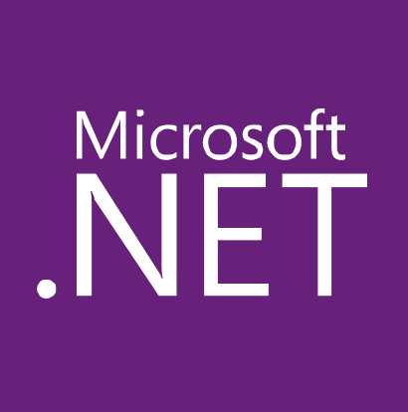



















Build and run open source solutions
Open and Hybrid
Applications
DevOps
Frameworks
Databases & middleware
Containers
Infrastructure
Notes:
We’re heavily invested in open-source technologies and partnerships, as evidenced on this slide. Nearly one in three Azure virtual machines are now running Linux, and we support Linux as a first class citizen.
Why is this important to Microsoft? Because it’s in the best interest of our customers. In fact, over 40% of CIOs are using open source as their primary strategy heading into 2017. We support our customers’ computing, whatever it is and wherever it is.
Finally, we contribute to the open source community as well as build some of our services on open source technology, like HDInsight and Azure Container Service. This also helps us scale to our customers’ needs as we rapidly release cloud solutions.

Slide 15

Consistent identity, apps, data & management
Open and Hybrid
Cloud
Azure Active Directory
Azure management and security
Azure
data services
Azure services
Common Identity
Integrated Management and Security
Consistent Data Platform
Unified Development and DevOps
On-Premises
Active
Directory
On-premises
infrastructure
SQL Server
Azure Stack
Notes:
We understand you have a complex environment, running both on-premises and a cloud environment. With Azure, you can take your existing IT environment, and consistently extend from on-premises to the cloud, or vice versa. Azure offers hybrid consistency everywhere: in application development, management and security, identity management, and across the data platform.​
​
Azure​
· Azure’s true hybrid capabilities give you the flexibility to go to the cloud on your terms.​
· True hybrid isn’t just about infrastructure and connectivity — it offers consistency across your identity, management, data and development, whether on-premises or in the cloud. In addition, Microsoft has developed a broad range of cloud and on-premises technologies that work together across environments. ​
​
Here are a few examples of how we’ve built in consistency to help you more easily manage a hybrid environment: ​
First, Azure Active Directory now extends Active Directory to allow single sign-on for users and protect access to data that flows across cloud and on-premises applications.​
Azure management and security services give you visibility and control across your cloud and on-premises infrastructure with simplified operations management and security. ​
Both SQL Server and Azure SQL Database now use a common T-SQL query language. This means you can seamlessly distribute data between on-premises and the cloud. ​
And finally, Azure Stack provides Azure services in on-premises datacenters. This means you can use a single set of APIs and tools to deploy applications anywhere. It gives your developers a common approach to building applications and the flexibility to choose where they run​

Slide 16
Trust
Protect your business
Open and Hybrid
Build freely, deploy consistently in the cloud & on-prem
Microsoft Azure
App Innovation
Accelerate innovation with the cloud
Data-Driven Intelligence
Power decisions & apps with insights
Notes:
Microsoft Azure is our cloud platform for digital transformation across your business. Our strategy to this end is to provide a platform of technologies that:
1. Accelerates app innovation through rapid app development and agility in the cloud.
2. Delivers integrated data and intelligence—data for rich insights to intelligence embedded within apps.
3. Is open and flexible, where you can use the tools and technologies you already have and want to use.
4. Is trusted to protect your business assets. As more customers expect digital experiences, they expect the data they share with an organization to be protected. We help you do that.

Slide 17
Accelerate innovation with the cloud
App Innovation
Build apps faster and easier
Manage applications proactively
Deliver native mobile apps seamlessly

Slide 18



Build apps faster and easier - IAAS
App Innovation
VM
Containers
Service Fabric
Other
Legacy applications, no change
Efficiency and speed
Always-on, scalable, distributed applications
Cloud Foundry, OpenShift, Apprenda, Jelastic, etc.
Lift and shift
Improved DevOps
Hyperscale
(e.g. IOT)
Third-party frameworks
Notes:
Build on the OS: Virtual Machines are the “base unit” for moving workloads to the cloud. The Azure Container Service provides a really fast way to get containers into production with a choice of popular open source container orchestration solutions: DC/OS or Docker Swarm
Service Fabric: is a platform that developers and ISVs can use to build and manage custom microservice-based applications at cloud scale and with 24x7 availability. Microservices are an architectural approach based on fine-grained, loosely coupled services that can enable advanced developer agility
Other PaaS: all PaaS runs great on Azure! Azure supports the leading third-party PaaS framework providers like Cloud Foundry and OpenShift.

Slide 19

Build apps faster and easier - PAAS
App Innovation
< DEVELOPERS
NON-DEVELOPERS >
App service
Functions
Logic apps
Power apps
Web, mobile, and API apps
Serverless compute
Workflow & Integration
Self-service
Web and mobile
Event-driven microservices
LOB integration and hybrid apps
No-code apps
Notes:
App Service: is a set of services that has everything you need to build apps that target both web and mobile clients from a single app back end. Supporting a range of language options—.NET, Node.js, Java, PHP, and Python—it consists of Web Apps, Mobile Apps, Logic Apps, and API Apps.
Functions: provides serverless, compute for event-driven solutions that extends the existing Azure application platform with capabilities to implement code triggered by events occurring in other Azure services, SaaS products (like Office365 and Salesforce.com), and on-premises systems.
Cloud Services: was the original Microsoft platform as a service (PaaS) service launched in 2010. Inspired by the needs of developers, Cloud Services enabled them to easily deploy .NET applications, taking advantage of cloud infrastructure like Virtual Machines and Virtual Networks without having to manage the low-level details and configuration of Windows Server and the underlying infrastructure.
Other PaaS: all PaaS runs great on Azure! Azure supports the leading third-party PaaS framework providers like Cloud Foundry and OpenShift.

Slide 20

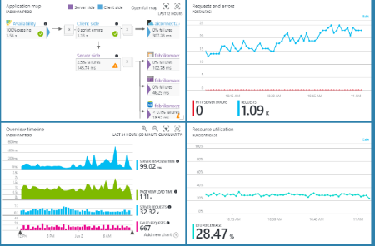
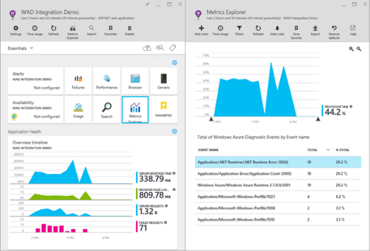
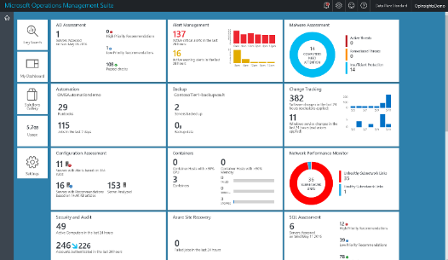

Manage applications proactively
App Innovation
Azure Portal
Application Insights
Operations Management Suite
Notes:
To begin, on the left we have the Azure Portal. When you sign up for Azure you get the ability to build dashboards that include monitoring, metrics for individual resources, topology views, and more—this is something each user can personally configure.
When building applications, many groups leverage Application Insights for monitoring within the DevOps process. Application Insights integrates with the Azure portal to view metrics directly from applications, as well as application dependencies.
Finally, on the right, Operations Management Suite pulls together cloud, on-premises, and multi-cloud into one view for management as well as security across Azure, but also AWS, Windows Server, Linux, VMWare, OpenStack, etc.

Slide 21

Deliver native mobile apps seamlessly
App Innovation
Mobile DevOps
Mobile Back-end Services
Code Repository
Build + Deploy
Automated Testing
User Testing
Cloud and Offline Data
User Authentication
Backlog
Push Notifications
Monitor and improve
Notes:
With HockeyApp we can manage beta distribution, get real-time crash reports, and engage with customer feedback for continuous integration.
Azure Mobile App Service provides the back-end services that customers require, including offline data sync, user authentication, and push notifications. Mobile App Service is also tool agnostic, so whether you’re using Xamarin/HockeyApp or another tool, you can leverage the mobile back-end services all the same.

Slide 22
Trust
Protect your business
Open and Hybrid
Build freely, deploy consistently in the cloud & on-prem
Microsoft Azure
App Innovation
Accelerate innovation with the cloud
Data-Driven Intelligence
Power decisions & apps with insights
Notes:
Microsoft Azure is our cloud platform for digital transformation across your business. Our strategy to this end is to provide a platform of technologies that:
1. Accelerates app innovation through rapid app development and agility in the cloud.
2. Delivers integrated data and intelligence—data for rich insights to intelligence embedded within apps.
3. Is open and flexible, where you can use the tools and technologies you already have and want to use.
4. Is trusted to protect your business assets. As more customers expect digital experiences, they expect the data they share with an organization to be protected. We help you do that.
Let’s discuss these areas in more detail.

Slide 23
Power decisions & apps with insights
Data-Driven Intelligence
Support business strategy with any data
Predict and respond proactively
Learn and engage with artificial intelligence
Notes:
Let’s look at some of the key benefits of Azure data and intelligence.

Slide 24
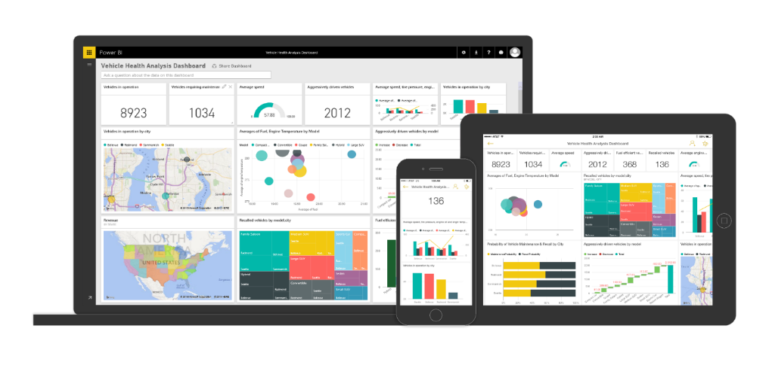
Support business strategy with any data
Data-Driven Intelligence
Back-end power
Front-end insights
Big data
Web data
Traditional data

Slide 25
Predict and respond proactively
Data-Driven Intelligence
Azure machine learning templates
Azure machine learning service
Demand forecasting
Predictive maintenance
Vehicle telemetry
Data
Modeling & APIs
Clients
ML STUDIO
API
Big data
Web data
Traditional data

Slide 26


Learn and engage with artificial intelligence
Data-Driven Intelligence
Litware Insurance
Interact in personal, natural ways
Smart Recommendations, personalization, immersive experiences
Recognize images with Computer Vision
Greeting
Prompt with choice
Integrate with Dynamics CRM to surface relevant suggestions
Infuse processes with intelligence
Dynamics CRM
Generate quotes based on smart insights
Prompt for text
Natural language parsing to identify intent
(translation when necessary)
Analyze sentiment
Capitalize on hidden insights beyond your data
Advanced Analytics, Machine Learning, Data Enrichment
Cognitive Services enable interaction through voice or text
Live agent handoff
Litware Insurance Bot
Has joined the conversation
Type a message…
Hi! How can I help you today?
Where is Litware based?
Litware has an office in Redmond, Washington.
Can I help with anything else?
I need to buy insurance
No problem! Are you an existing customer?
Yes
What is your name?
Shelly Smith
What are the last 4 digits of your social security number?
1234
I’ve found your existing policies. If you insure your new car with us, you’ll get a 10% multi-policy discount.
I can also see that your daughter on your other policy just turned 16 years old. Should I include her on this one as well?
Yes
No
No
What kind of vehicle are you adding today?
SUV
Crossover
Hybrid Sedan
Hybrid Sedan
Please upload a picture of the vehicle.
Congratulations on your new car! Now generating quote…
We can provide comprehensive insurance for $124.49 a month. Would you like to proceed with enrolling in coverage?
No, I am unsatisfied
Ok, I’ll connect you with an agent who can explain your coverage options.
Notes:
Cognitive Services includes APIs for vision, speech, language, knowledge, and search.
Bot Framework includes a connector, to text/sms, O365, Slack, etc., an open source SDK, and a directory of public bots.

Slide 27


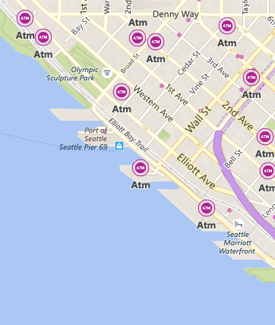

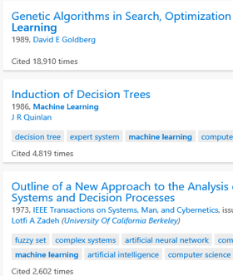


Learn and engage with artificial intelligence
Data-Driven Intelligence
VISION
SPEECH
LANGUAGE
KNOWLEDGE
SEARCH
Computer Vision
Speech-to-Text and Text-to-Speech Service
Natural Language Processing
Knowledge Exploration Service
Bing Search
What is in the image?
Give me directions to the closest ATM
Play today’s Daily Show
Top publications in AI?
Search for ‘cute kittens’
Category | People; 1 face
Adult / Racy? | False / True
Dominant colors
Accent color
Convert spoken audio to text
Convert text to spoken audio
Extract intent of user
Notes:
Cognitive Services includes APIs for vision, speech, language, knowledge, and search.
Bot Framework includes a connector, to text/sms, O365, Slack, etc., an open source SDK, and a directory of public bots.

Slide 28
Trust
Open and Hybrid
App Innovation
Data-Driven Intelligence

Slide 29
Azure Portal Demo

Slide 30
Resource Links
Azure Trial
http://aka.ms/tryazure

Slide 31
Q&A

Slide 32
Keep in touch!
Contact Information
Joe.Raio@Microsoft.com
http://joeraio.com
Follow me on twitter @joescars
Download this presentation:
www.slideshare.net/joeraio

